Slide 1
Thee Deciders
Our Team
Sibusisiwe Myeki
Gumbi Sibongile
Langa Monelisi Mdubela
Chuma Raxothi

Slide 2
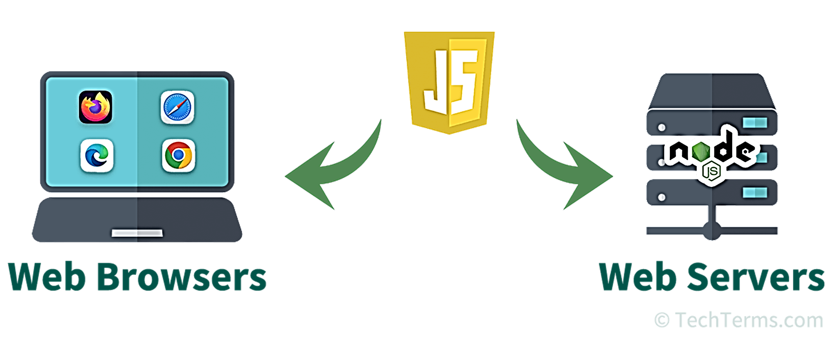
Introduction to Node JS

Slide 3
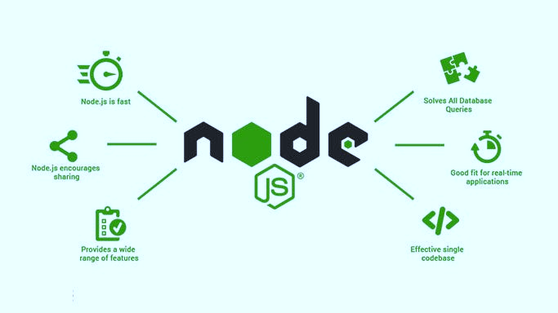
NodeJS
Open-source JavaScript runtime environment
It runs JavaScript code outside of a web browser
allowing web developers to use JavaScript as the back-end of their web applications.
Node.js is also cross-platform and runs on Windows, Unix, Linux, and macOS.

Slide 4
How to run Node.js files in VS Code: A Step-by-Step Guide
Vs Code
Command Prompt
Package.json file:npm init
Install expresspackage:npm install express
Production depencies
Development dependencies
Peer dependencies
Optional dependies
Bundles dependencies
Editors
Node Packages Manager
Dependencies/Libraries

Slide 5
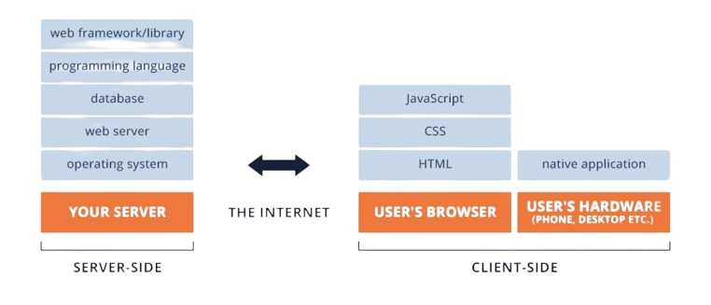
Client-Side Game Development
Client-Side Game Development with Node.js: Client-side game development typically involves creating games that run in a user's web browser. Node.js, although primarily a server-side runtime, can be used in conjunction with various libraries and frameworks to assist in client-side game development. Some common technologies used in this context include HTML, CSS, and JavaScript

Slide 6


Assigning a Sprite to a player
In game development, a sprite is a 2D image or animation that represents a game object or character.
Assigning a sprite involves loading and displaying these images or animations in the game world. Node.js can help with managing assets and game logic on the server side, while client-side technologies like HTML5's canvas or WebGL can be used to render and control the game sprites on the user's browser.

Slide 7
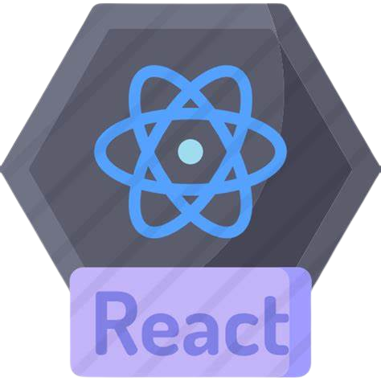
What is React Native?
React Native (also known as RN) is a popular JavaScript-based mobile app framework
that allows you to build natively-rendered mobile apps for iOS and Android.
The framework lets you create an application for various platforms by using the same codebase.
Notable Apps Built with React Native
Facebook Ads Manager
Instagram
Airbnb (previously)
Bloomberg

Slide 8
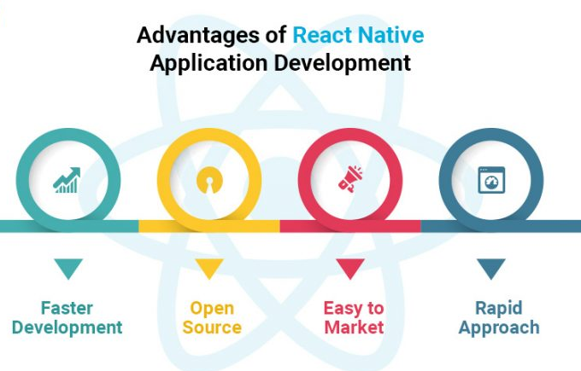


Advantages of React Native
Faster Development
Open Source

Slide 9
To develop React Native applications and build the chat app, you'll need to install the following dependencies
React
A very popular JavaScript DOM rendering framework for building scalable web applications using a component-based architecture..
Pusher
Pusher is a technology used to create apps with real-time features like push notifications and pub/sub messaging. It powers the real-time capabilities of our chat app.
R
p
This is a framework for creating server-side rendered (SSR) React applications. It simplifies the challenges of building SSR React apps.
NextJS
Sentiment is a module that performs sentiment analysis on text using the AFINN-165 wordlist and Emoji Sentiment Ranking.
Sentiment
NJS
s

Slide 10
React Native Chats
React Native Chats typically refers to the implementation of chats or messaging features in a mobile application built with react native.
-React Native is popular framework for developing cross-platform mobile applications using JavaScript and React.

Slide 11
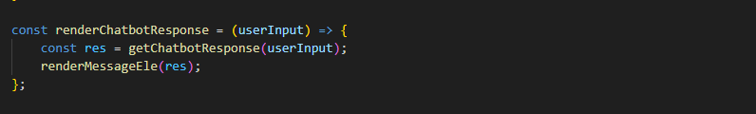
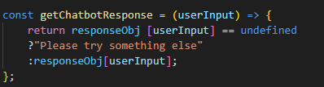
When displaying messages
When displaying messages in a chat component in JavaScript, you’ll need to create a mechanism to render messages in a user-friendly and visually appealing way.
If the user input is not in our object keys then the chat box will write undefined then tells the user to try something else

Slide 12
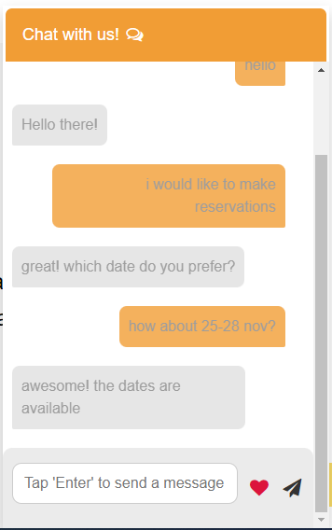
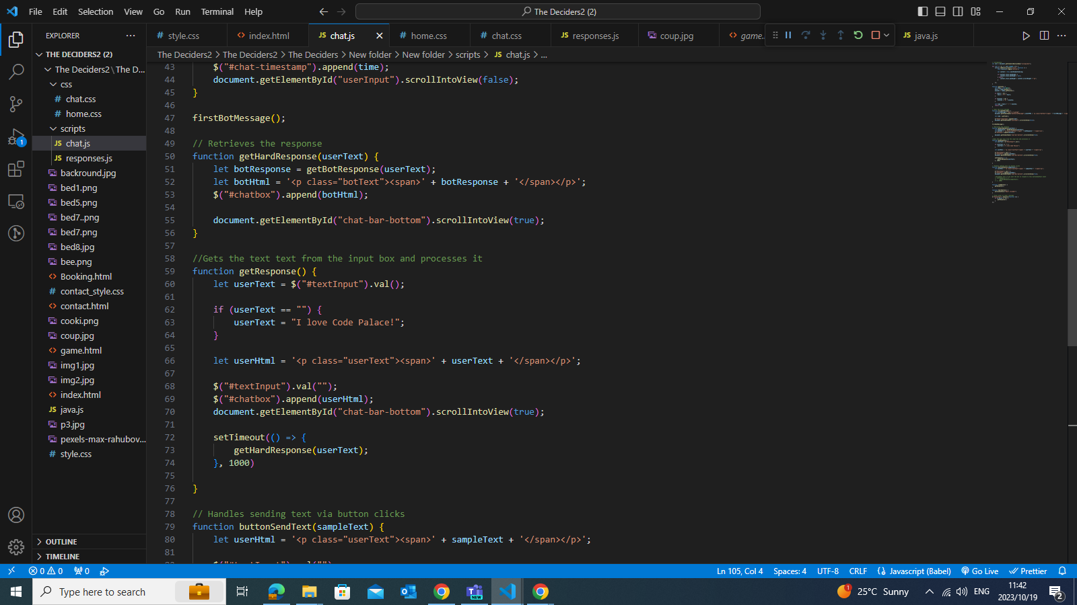
Implementation of chatbot
We created a render chat bot response that takes the user input and pass it to render Message Element then display's the response.

Slide 13
Thank you

